Slide 1

SAP Analytics cloud training
Anubhav Oberoy
Day 19

Slide 2

Live Data Connection with HANA Cloud
Install a generator (template)
Use generator to generate project
Download the Adaptor from sap site
Drag drop adaptor to the project
Build and deploy adapter project to SAP BTP
SAC
(SaaS to consume data and build dashboards)
SAP HANA Analytic Adapter
HANA Cloud
(HANA DB working as a Database as a service)
Create a HANA Cloud Instance in free trial a/c
Create a database project using BAS
Create a db table, interface, csv, Calc. view
Deploy these objects ➔ CUBE
www.anubhavtrainings.com

Slide 3
Step 1: HANA Native Development
Create a dev space in SAP Business application Studio tool with Full stack cloud development along with hana plugins being enabled
Select create project from template and choose HANA Database project
Enter project name, module name, namespace and bind to hana cloud instance Yes
Connect to our SAP BTP account by logging in using API end point url and provide dev space in dropdown
We give a unique container name (a container is a collection of all our database object, it contains tables, views, sequences, procedures, functions,..) ➔ anubhavhdi
A skeleton of project is created now.
Next step is to create a database table in that project under the src folder
Uploaded the table, tabledi, and csv from study material to src folder
Come down to hana project section and click rocket icon to deploy our objects
Press F1 key and open HANA Database Explorer tool where we can check our container and db objects
Add container to see our db table and open data to view data
Choose F1, Create new HANA Database artefact and choose calculation view
Create a calculation view with project node, select table and drag drop all fields, same for agg level
Make Id as dimension and deploy the view to hdi container
We can cross check the CUBE in HANA DB Explorer tool under container if its there or not.
www.anubhavtrainings.com

Slide 4
Step 2: Create Adapter for HANA int.
Press F1 and choose explore and install generator
Search for haa generator, choose the first one and install
F1 and choose Run generator and select haa:app generator from the list
Provide a project name as hanaadp
And now we give our container from from step 1 = anubhavhdi
A project skeleton is created, now we download an hana analytic adaptor and upload it to the project folder
To download it we goto https://tools.hana.ondemand.com/#hanatools
Download xsahaa-release-2.1.5-release.zip
Extract the zip and you see a folder created, from that folder drag java-xsahaa.war and drop to the BAS tool under project>hanadp>srv>target
Right click on mta.yaml and choose build MTA project
An mta_archieve folder with mtar gets created, Right click on mtar file and deploy MTAR
The application for adapter is very secure, we need to grant a role collection permission to even ourself to be able to consume data via this adapter (public cloud app)
Try to access adapter with URL – https://7e7b2249trial-dev-hanaadp.cfapps.us10-001.hana.ondemand.com/sap/bc/ina/service/v2/HeartBeat we get permission error
Now we go to sub account under security find role collection hanaadp_Viewer
Assign the role to our own user (email) and check heartbeat of ina service again
www.anubhavtrainings.com

Slide 5
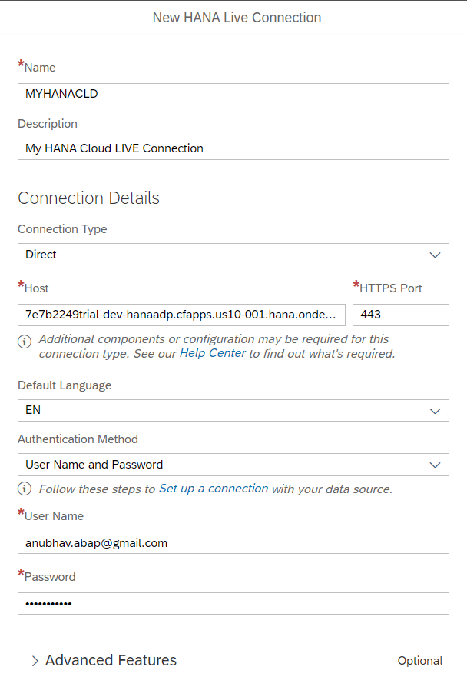
Step 3: SAC live connection to HANA
Switch over to SAC system
Go to connections and add a LIVE data connection with HANA Cloud
Choose Direction, enter the URL of adaptor with port no 443
Provide our SAP BTP user id and password with language EN
Click Create
www.anubhavtrainings.com

Slide 6
New LIVE Data Connection with BW
www.anubhavtrainings.com

Slide 7
End of Day 19

Slide 8

Questions

Slide 9

Anubhav Oberoy
anubhav.abap@gmail.com

